Slide 1
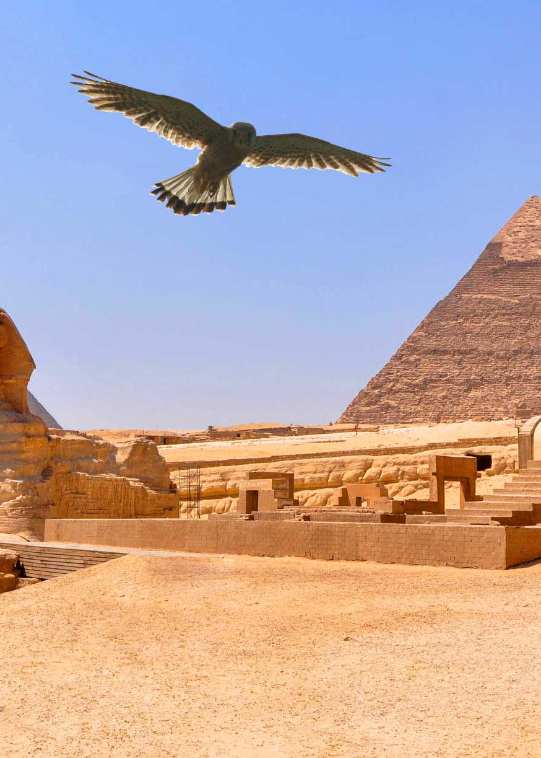
Mathematics in Ancient Egypt
The Birth of Mathematics
Mathematics is believed to have originated in Ancient Egypt, according to two viewpoints. The Greek historian Herodotus proposed that mathematics was born in Egypt, as he observed how the annual flooding of the Nile River led to the recalculation of field areas and the development of geometry. On the other hand, Aristotle offered a different perspective, suggesting that mathematics emerged in Ancient Egypt due to the intellectual pursuits of the clergy(religion men) who had a lot of free time.

Slide 2

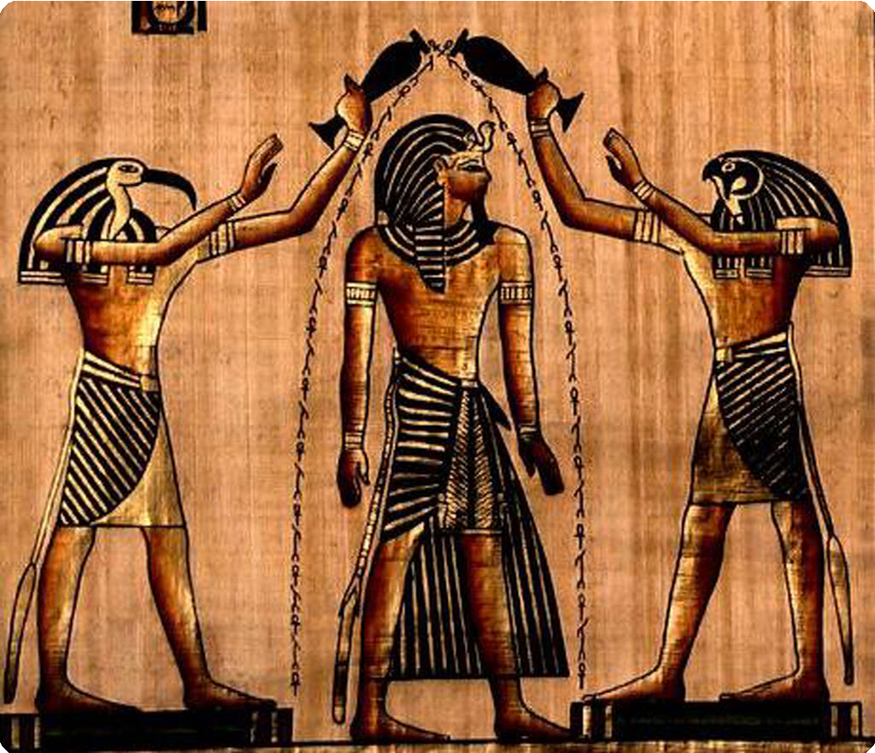
The Nile River
Clergy

Slide 3

While the certainty of these views remains unproven, it is likely that both hold some truth. During this time, mathematics primarily served practical needs such as timekeeping, accounting, construction and inheritance distribution. It played a crucial role in societal progress, enabling tasks like tax collection, crop estimation and architectural achievements like the pyramids. However, there are few existing documents on Ancient Egyptian mathematics due to their use of papyrus, which does not withstand long time. The burning of the library of Alexandria also led to the destruction of written resources from this period.

Slide 4
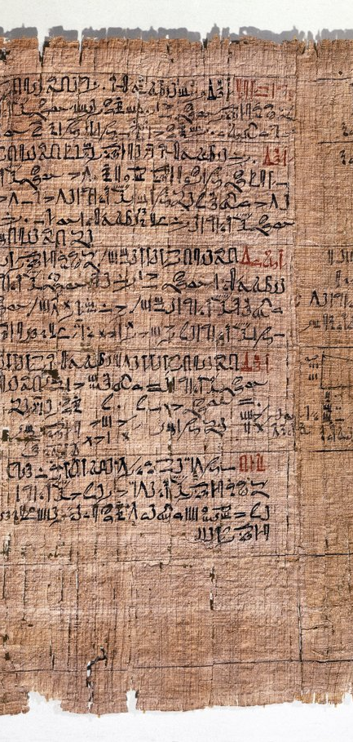
Ahmes Papyrus
The Ahmes Papyrus, dated to around 1850 BC, is approximately 6 meters long and 35 centimeters wide. Its purpose was to serve as a mathematical instruction manual. The papyrus begins with a few exercises involving operations with fractions, followed by 87 questions accompanied by complete solutions. These questions cover various arithmetic operations, such as interest calculations and finding the areas of geometric shapes encountered in daily life. For instance, one problem involves solving an equation with one unknown: "What number gives 19 when 1/7th of that number is added to itself?" (modern representation: x + x/7 = 19). The Egyptians attempted to find the solution through trial and error.

Slide 5
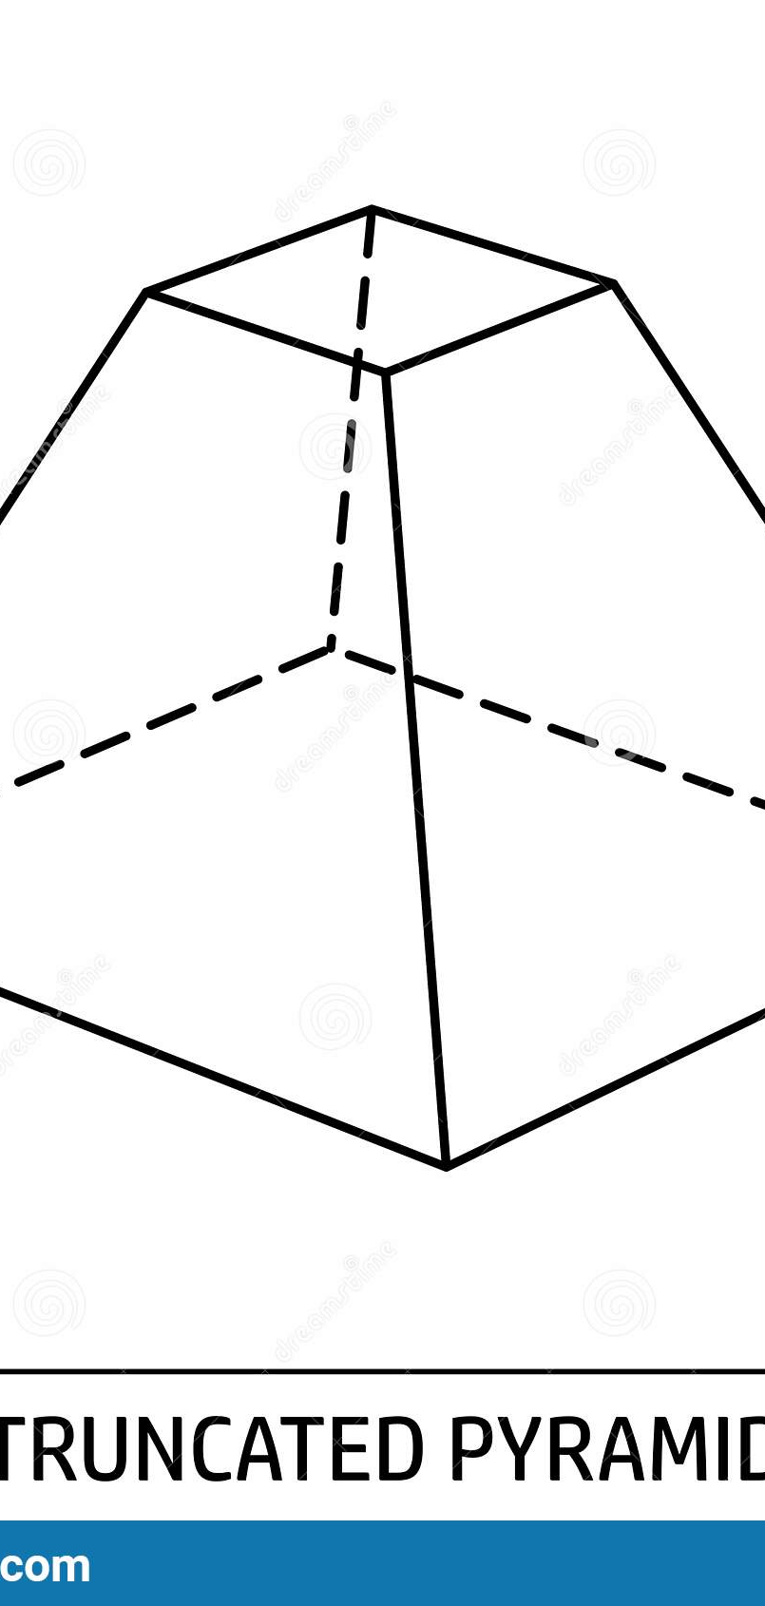
Moscow Papyrus
The Moscow Papyrus, written around 1600 BC, consists of 25 questions. Although most of these questions are of similar difficulty to those in the Ahmes Papyrus, two stand out as exceptionally challenging. Given the level of mathematical knowledge during that period, it is remarkable to find such complex questions. The first question deals with finding the volume of a truncated pyramid, which suggests its relevance to the construction of pyramid-shaped mausoleums at the time. The second question is even more difficult, involving the calculation of the volume of a divided sphere piece resulting from a line cutting through a sphere. Both of these questions were correctly solved and are considered the pinnacle of Egyptian mathematics.

Slide 6
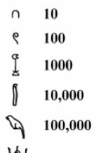
The Number System of Ancient Egypt
The Ancient Egyptian number system is considered the earliest developed numerical system in history. It is a base 10 system, similar to the Roman numerals. However, the shapes used in the Ancient Egyptian number system were challenging to use. One significant drawback was the difficulty in expressing numbers greater than 1 million. To represent such large numbers, the symbol of a "confused man" was utilized, indicating that numbers beyond 1 million were incomprehensible. In Ancient Egypt, numbers and numerals were formed by combining seven distinct symbols or shapes. For example, a vertical line represented 1, a horseshoe shape represented 10 and a hook sign represented 100. Expressing the number 90 required the use of nine symbols, while 99 necessitated 18 symbols and 999 required 27 symbols.

Slide 7
Basic math operations
The Ancient Egyptians often made calculations by hand. For example, if they wanted to calculate the sum of 3 cats and 4 dogs, they would represent the symbol for 3 cats with triangles and the symbol for 4 dogs with squares. By placing these symbols side by side, the sum could be found.

Slide 8
Multiplication
The Ancient Egyptians used an interesting way to multiply two numbers. The algorithm draws on the binary system: multiplication by 2. They used addition to get the answer to a multiplication problem. This method is still used in many rural communities in Russia, Ethiopia and the Near East. The term that we use with Egyptian multiplication is called “doubling”. You take one number and either multiply it by 2 or you add it to itself. This is done repeatedly until you get the other number.

Slide 9

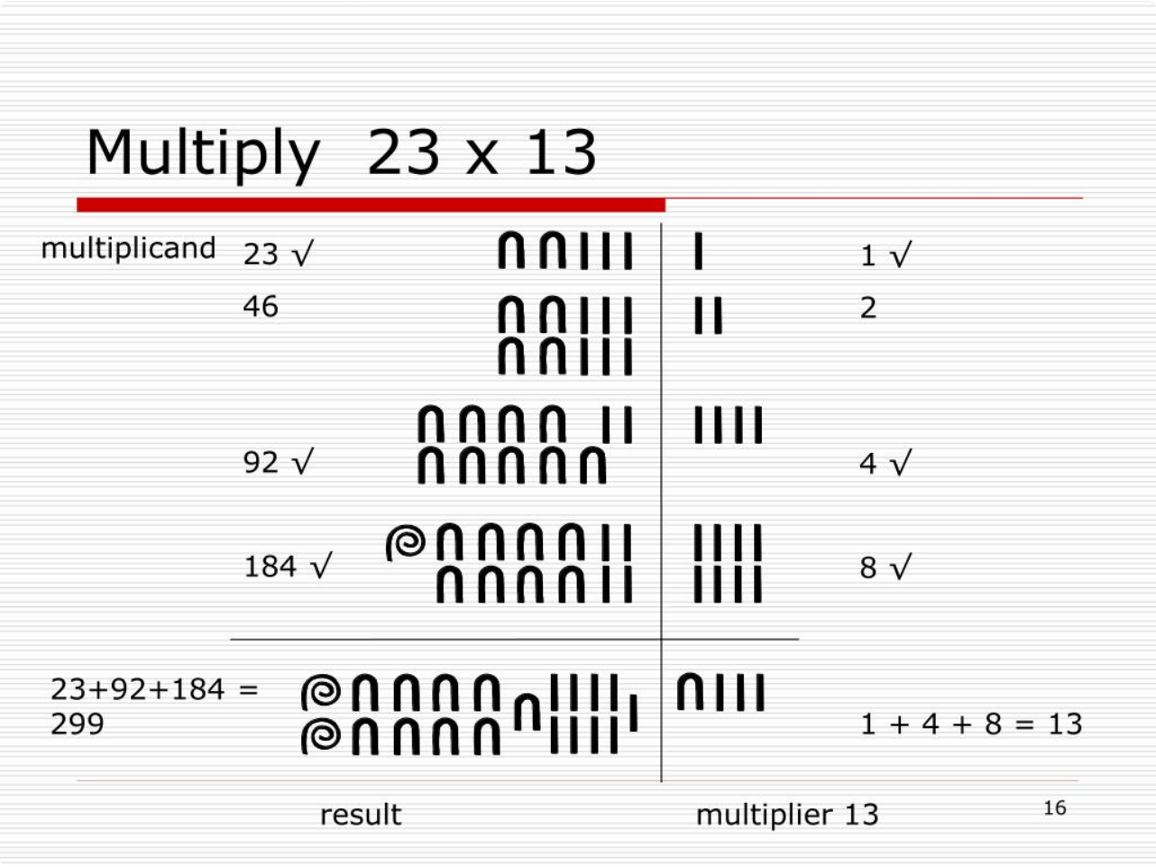

Slide 10
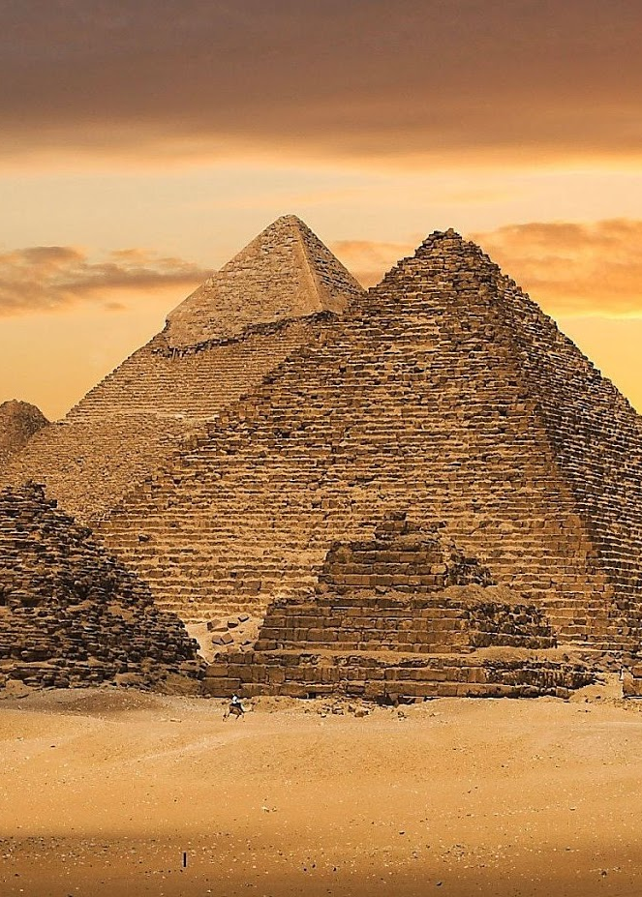
Geometry
Ancient Egyptians used geometry to build structures like pyramids and temples. They applied principles of similarity to ensure proportional dimensions in pyramids. They also understood the 3-4-5 triangle for right angles. Geometry helped determine the junction points of walls in temples. Egyptians excelled in calculating area and volume, multiplying base by height for triangles and length by width for rectangles. Their geometric mastery was essential for their architectural achievements.

Slide 11
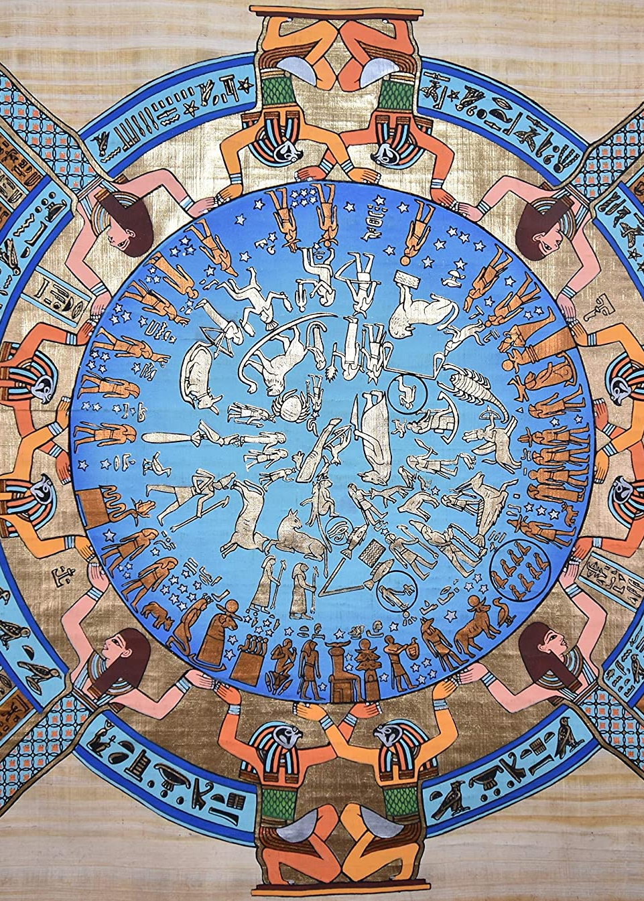
Calendar
The Ancient Egyptians created their solar calendar by observing the connection between nature and the stars. They noticed that when the Sirius Star rose, the Nile River would overflow. Their calendar had 12 months of 30 days each, with 5 additional holiday days. Daylight hours were measured using sundials and water clocks were used when sundials couldn't function. Unlike lunar-based calendars, the Egyptians relied on the regular movements of the sun for more accurate yearly measurements. Their calendar assumed a year of 365 days, divided into 12 months with 3 weeks of 30 days each. However, because it was slightly shorter than the actual solar year, it lost one day every four years compared to the Gregorian calendar. Astronomical observations and recordings of specific star positions helped adjust their calendar accurately each year.

Slide 12

Conclusion
The Ancient Egyptians possessed advanced mathematical knowledge, attracting the interest of Greek mathematicians who sought to learn from them. While they did not focus on formal axioms or establishing relationships between numbers like modern mathematicians, their problem-solving methods through trial and error were remarkably effective. As a surprising example, although there are many modern methods, supercomputers still use these fundamental methods when performing complex calculations. The legacy of Egyptian mathematics endures as it continues to influence modern mathematical thinking and problem- solving approaches.
Thank you for your attention.
Ömer Diner

